Slide 1



Building an open source government application platform in the cloud
ALTINN 3
Rune T. Larsen
Nina Kylstad
Stephanie Buadu
11.06.2020
Notes:
Welcome to this session where we gonna talk about how we are building a open source government application platform in the cloud

Slide 2





Who are we?
Rune T. Larsen
Nina Kylstad
Stephanie Buadu
Building an open source government platform in the cloud
2
Copyright © 2020 Accenture. All rights reserved.
Notes:
We are 3 members of the team that is responsible for building the third generation of Altinn for the Norwegian Digitalization Agency. The teams consist of members from the agency itself and consultants from different companies.
Currently we have had around 30 contributors to our source code
My name is
Rune
Nina
Stephanie

Slide 3

Picture
Agenda
1
4
WHAT IS ALTINN
PUBLIC CLOUD COMPONENTS & ARCHITECTURE
2
5
INTRODUCTION TO ALTINN 3 PROJECT
STATUS & GOING FORWARD
3
6
OVERVIEW OF ALTINN 3
Q & A
Building an open source government platform in the cloud
3
Copyright © 2020 Accenture. All rights reserved.
Notes:
In this presentation we will give you an introduction to what Altinn is and the Altinn 3 project.
We will present the different solutions we are building as part of the new platform.
We will go in to details about the cloud components we are using
We will give you the current status and info on what we will be doing next.
And at the end we open up for questions and comments.

Slide 4




Government agency…
…needs data from population
Create digital service…
…to collect responses
Building an open source government platform in the cloud
4
Copyright © 2020 Accenture. All rights reserved.
Notes:
So what is Altinn?
Imagine you're a government agency that needs to get data from the citizens of Norway. Maybe you want them to report their Covid-19 symptoms.
Then Altinn is the platform to choose.

Slide 5
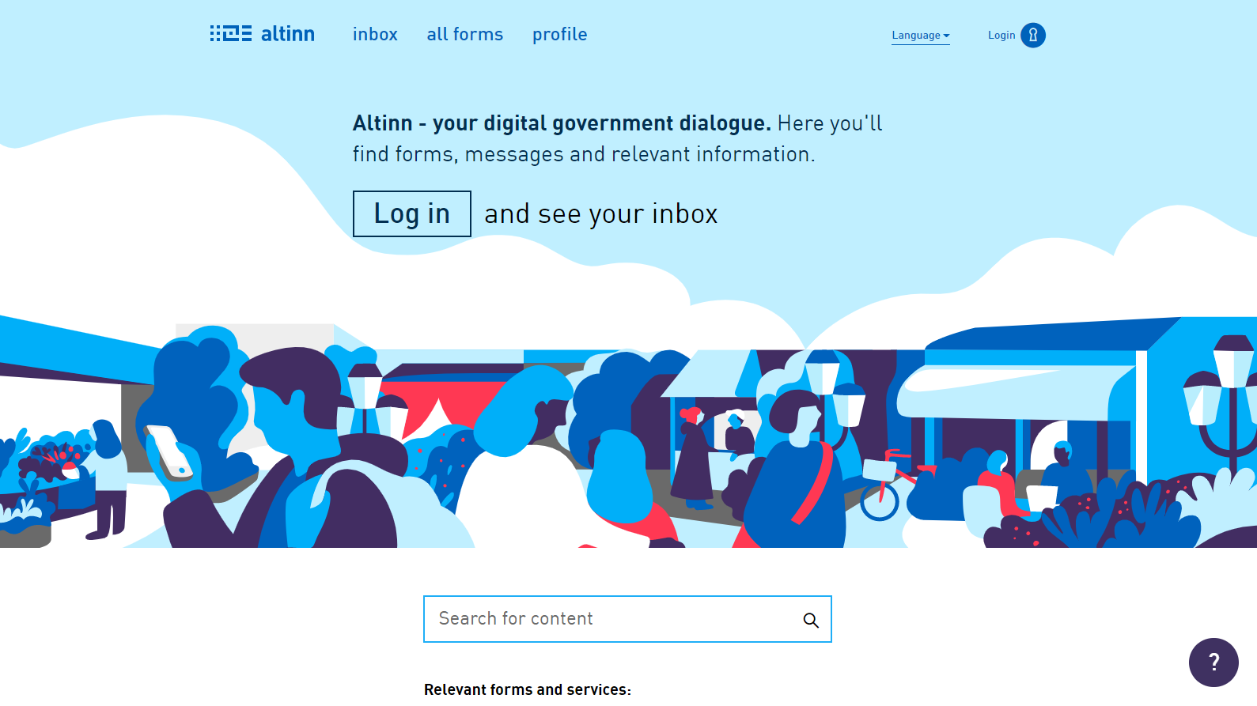
Notes:
Internet portal
Technical Platform
50 Agencies
1000 Digital services
Altinn is an internet portal for dialogue between businesses, private individuals and public agencies.
Altinn is also a technical platform that government bodies can use to develop and host digital services. Altinn was in fact one of the first platform as a service providers.
It started already back in 2002 when 3 agencies decided to join forces to create a common platform for reporting data to the government. The first generation was launched in 2003, the second generation was launched in 2010.
During this year's we have gone from 3 agencies to more than 50 like the Armed Forces, Police, Health and many more covering almost all sectors.
There is now more than 1000 digital services in production ranging everything from naming your firstborn to reporting a aircraft incident.

Slide 6
Percentage of users per age group
Building an open source government platform in the cloud
6
Copyright © 2020 Accenture. All rights reserved.
Notes:
Almost all businesses uses Altinn and this graph shows that almost all citizens from age 13 to 110 uses Altinn every year.

Slide 7
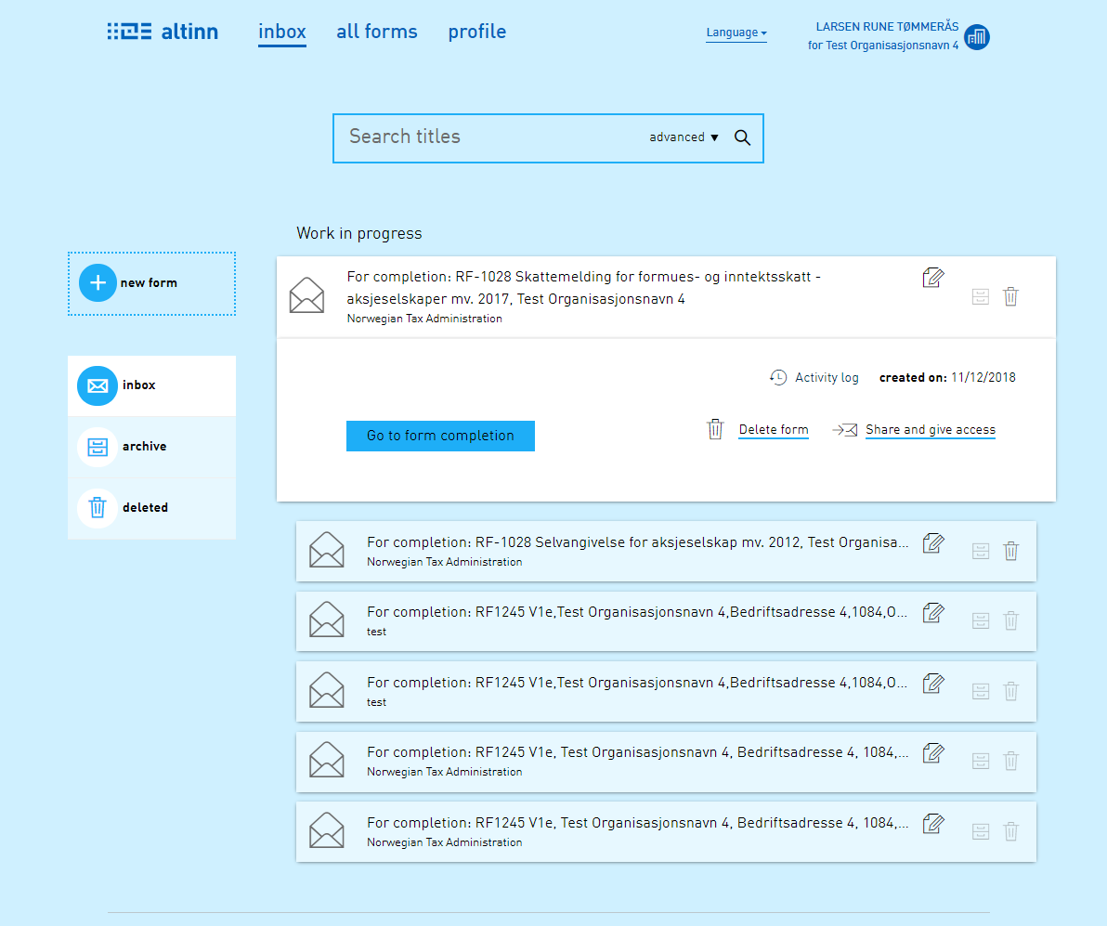
Everyone
has an Inbox
Building an open source government platform in the cloud
7
Copyright © 2020 Accenture. All rights reserved.
Notes:
In Altinn every citizen and business have their own inbox where they find there communication with the government.

Slide 8
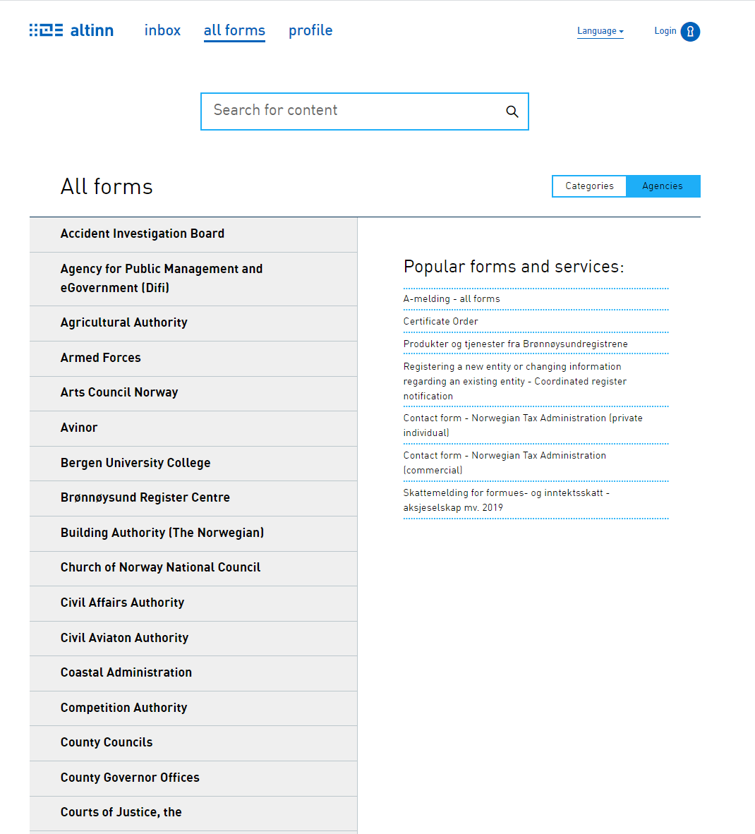
Service Catalogue
Building an open source government platform in the cloud
8
Copyright © 2020 Accenture. All rights reserved.
Notes:
They also have a service catalogue where they can find the digital service they need,-
Having a common platform is unique globally and Altinn is one of the main reason Norway has been considered being one of the leaders in digital government. Gartner consider Altinn to be one of the top 5 government technology platforms in the world.
One of the big reason for the success is that all functionality is also available through API’s. Around 50% of all traffic going through Altinn is done through API. More than 100 software vendors have implemented integration with the platform making it possible to submit your tax report directly from your financial system.

Slide 9
Government agency…
…needs data from population
Create digital service…
…to collect responses
Building an open source government platform in the cloud
9
Copyright © 2020 Accenture. All rights reserved.
Notes:
So back again to the agency that need this new digital service. Altinn sounds like the perfect government platform.
But there are some limitations on the second generation.

Slide 10
Daily traffic Altinn 2019
Building an open source government platform in the cloud
10
Copyright © 2020 Accenture. All rights reserved.
Notes:
It runs on physical servers, and even if traffic varies over the year, as this graph from 2019 shows, it is not able to quickly scale up and down making it to be fully scaled all year long.

Slide 11
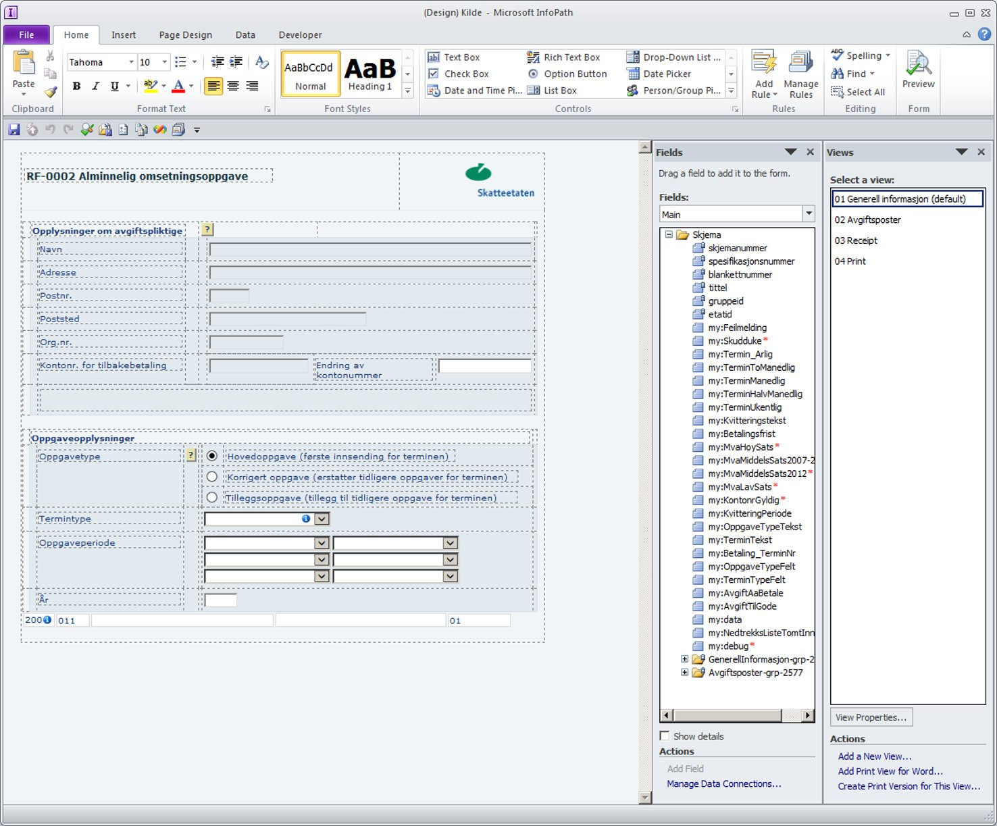
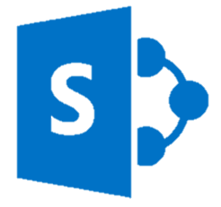

Limited UI possibilities
Building an open source government platform in the cloud
11
Copyright © 2020 Accenture. All rights reserved.
Notes:
And if you want a modern UI that works well on both mobile and desktop using the latest technologies,
You are limited by the fact that the platform is built around the outdated InfoPath tool and SharePoint.

Slide 12




Altinn 2.0 Limitations
Limited flexibility for process
Time consuming testing
Version control
Lack of self service
Building an open source government platform in the cloud
12
Copyright © 2020 Accenture. All rights reserved.
Notes:
The flexibility to define a process for the user of the digital services is also limited. The possibility is focused on either submitting or receiving data forcing you to split the digital service if you want 2-way communication.
If You want to quickly and iteratively test the digital service, to see if it looks good and works like you want to, you are slowed down since deploying to a test environment takes minutes _every time_ .
The current platform uses SharePoint for version control making it difficult to track changes done by you or other working on the same service.
And Once you are happy with the result, and want to deploy it to production, you need to request a technician to do the deploy.
So those are some of the limitations that we want to solve with the third generation

Slide 13
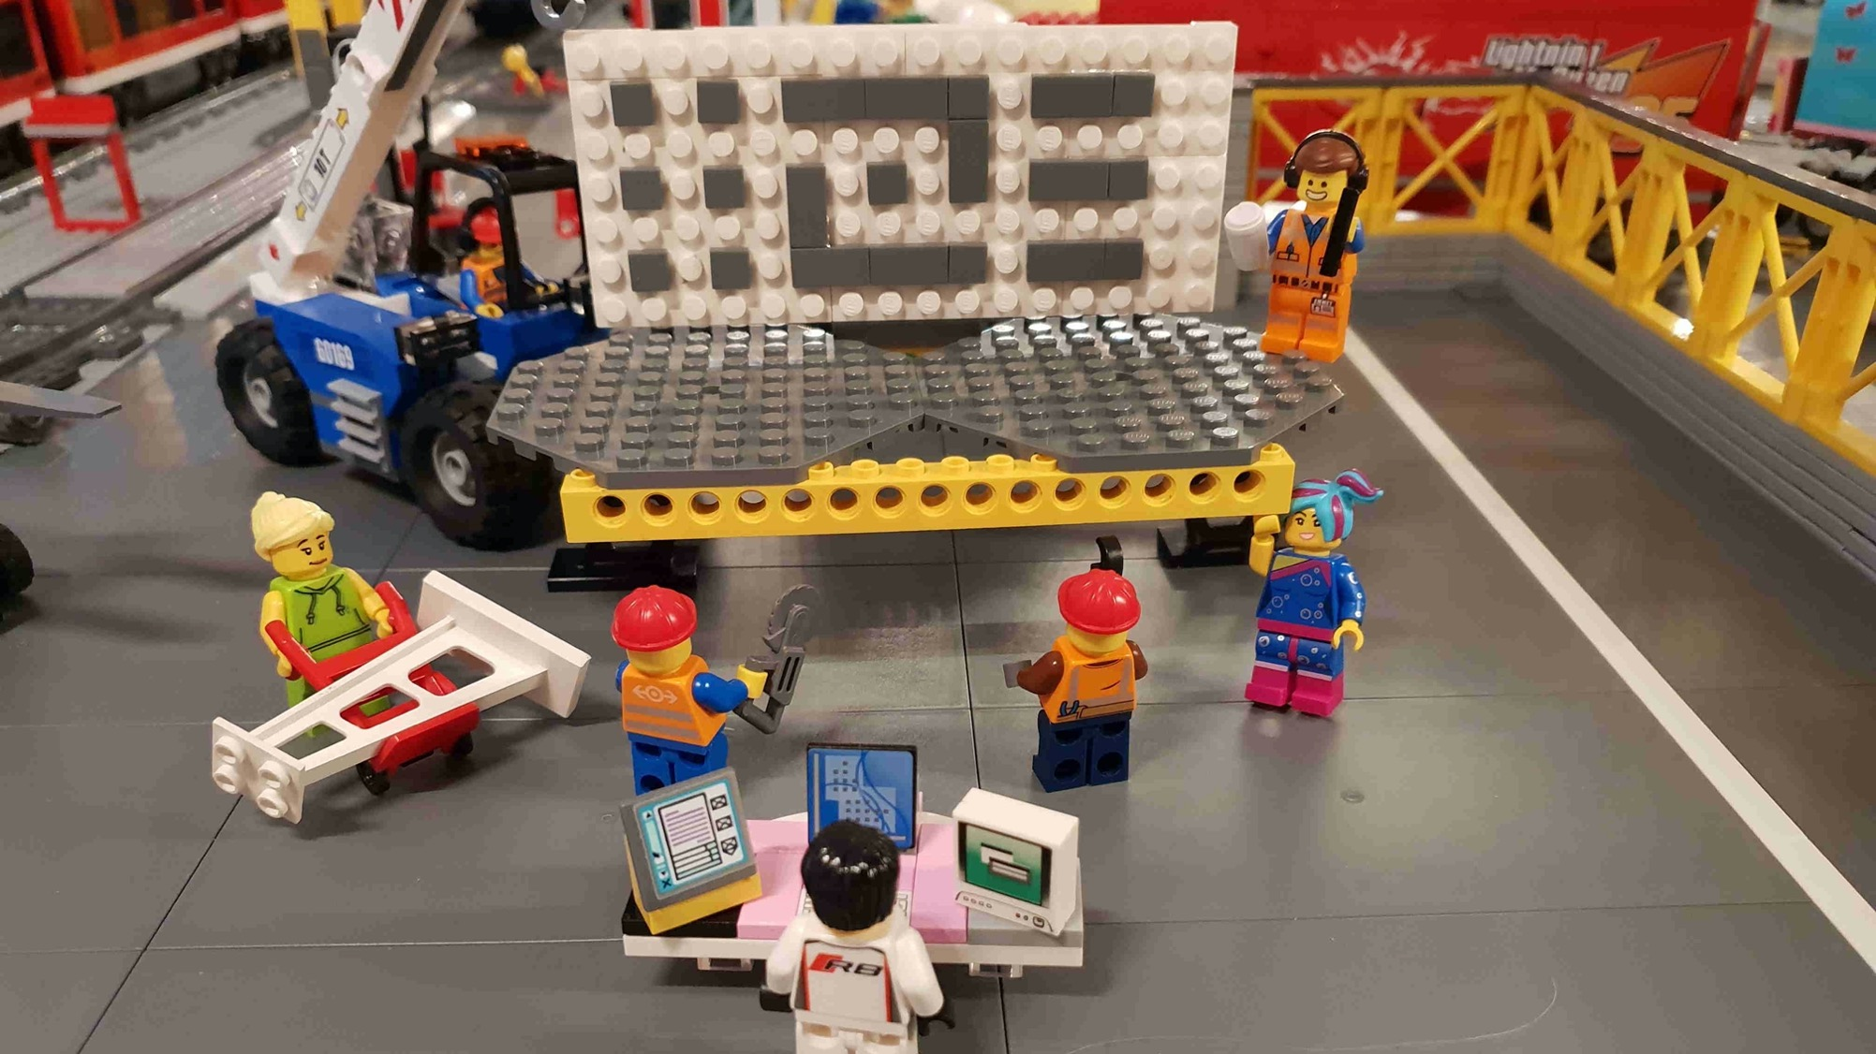
Building a new platform, one brick at a time…
Building an open source government platform in the cloud
13
Copyright © 2020 Accenture. All rights reserved.
Notes:
This project started back in 2016. We had then looked in to the existing products in the market to replace InfoPath and wanted to see if we were able to build something from scratch using .Net core.
We did a very small proof of concept and our conclusion was that it was possible.

Slide 14
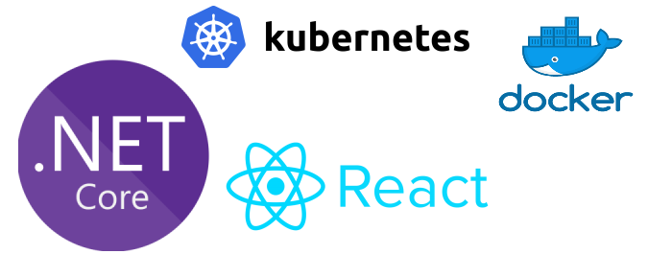
It all started with a proof of concept
Building an open source government platform in the cloud
14
Copyright © 2020 Accenture. All rights reserved.
Notes:
In the spring of 2018 we were ready to start a more extensive proof of concept.
Since 2016 a lot had happened, and the goal for the POC was to build a solution based around
.Net Core, React, Docker and Kubernetes in public cloud.
In the autumn of 2018 we felt that we had proved the main concept building a UI designer using REACT
Once that was completed the process to scope an Minimum Viable Product started in the summer of 2018.
This is the platform we are presenting to you today.

Slide 15

The concept
Building an open source government platform in the cloud
15
Copyright © 2020 Accenture. All rights reserved.
Notes:
Once the POC showed that we had a working concept, we started expanding on it.
In the old platform, we use the term «service» to encompass one specific form or message. For example, the tax return is a service. Change of address is another service. Service owners, like the Tax Administration, can configure their services to some extent, but are otherwise bound by the constraints of the platform. Each service can only be one of 4 types, and each type has a limited set of options to configure. Often there are needs that og beyond this, but implementing such needs for a single service is often not fesible.
We took the «service» concept of the old platform, and moved it to an application concept for the new platform, allowing _application owners_ a lot more freedom in how and what they create.

Slide 16


The concept
Develop alone, or together with others
Digital service
Deployed as a container
To public cloud
Building an open source government platform in the cloud
16
Copyright © 2020 Accenture. All rights reserved.
Notes:
The flexibility to define a process for the user of the digital services is also limited. The possibility is focused on either submitting or receiving data forcing you to split the digital service if you want 2-way communication.
If You want to quickly and iteratively test the digital service, to see if it looks good and works like you want to, you are slowed down since deploying to a test environment takes minutes _every time_ .
The current platform uses SharePoint for version control making it difficult to track changes done by you or other working on the same service.
And Once you are happy with the result, and want to deploy it to production, you need to request a technician to do the deploy.
So those are some of the limitations that we want to solve with the third generation

Slide 17
Architecture principles
Building an open source government platform in the cloud
17
Copyright © 2020 Accenture. All rights reserved.
Notes:
We defined several architecture principles for the new platform. 5 of the most important ones are.

Slide 18

Free and open-source software
Possibility to share the platform as Open Source. The possibility to create an Open Source community around the platform. No licensing cost
Code is shared on Github
Backlog on Github
No closed source products used
Others can reuse and modify components & solutions
Building an open source government platform in the cloud
18
Copyright © 2020 Accenture. All rights reserved.
Notes:
Free and open-source software
We want to share our platform with others for free. We want the possibility to create an Open Source community around the platform.
Code developed is shared on GitHub.
We have our backlog on GitHub.
We Can’t use closed source products in the platform
We Can’t use products with licensing limiting use and modifications
Others, like you can reuse and modify our components and solutions

Slide 19
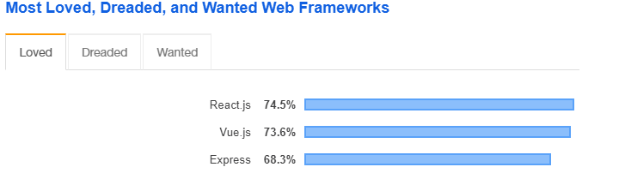
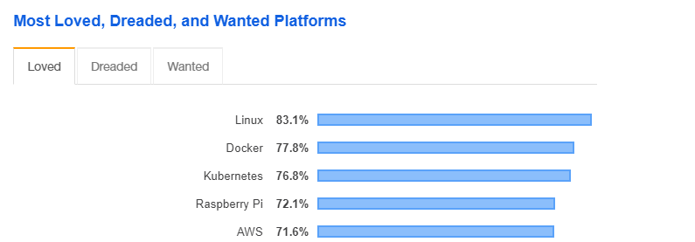
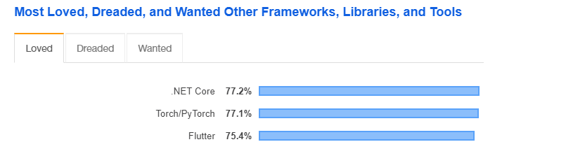
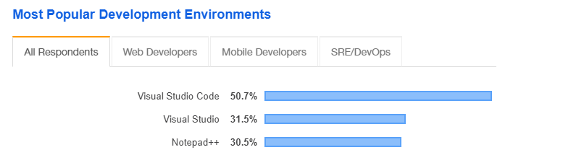
Build with modern and popular frameworks
We want people to love working on our platform and love to create apps on the platform
Building an open source government platform in the cloud
19
Copyright © 2020 Accenture. All rights reserved.
Notes:
Build with modern and popular frameworks
We really want our developers to love working on this platform, and we want that developers that is creating applications using this platform to love doing that. So we try to select the tools and frameworks developers love. So According to Stack Overflow we have
Selected the most loved web framework that is React
Selected the most loved backend framework that is .Net Core
Selected the 3 most loved platforms since we are using Linux Docker containers on Kubernetes
And we have Selected the most loved development environment since we are focusing the platform around Visual Studio Code.
We truly believe that developers would love working on our platform, I know we do.

Slide 20
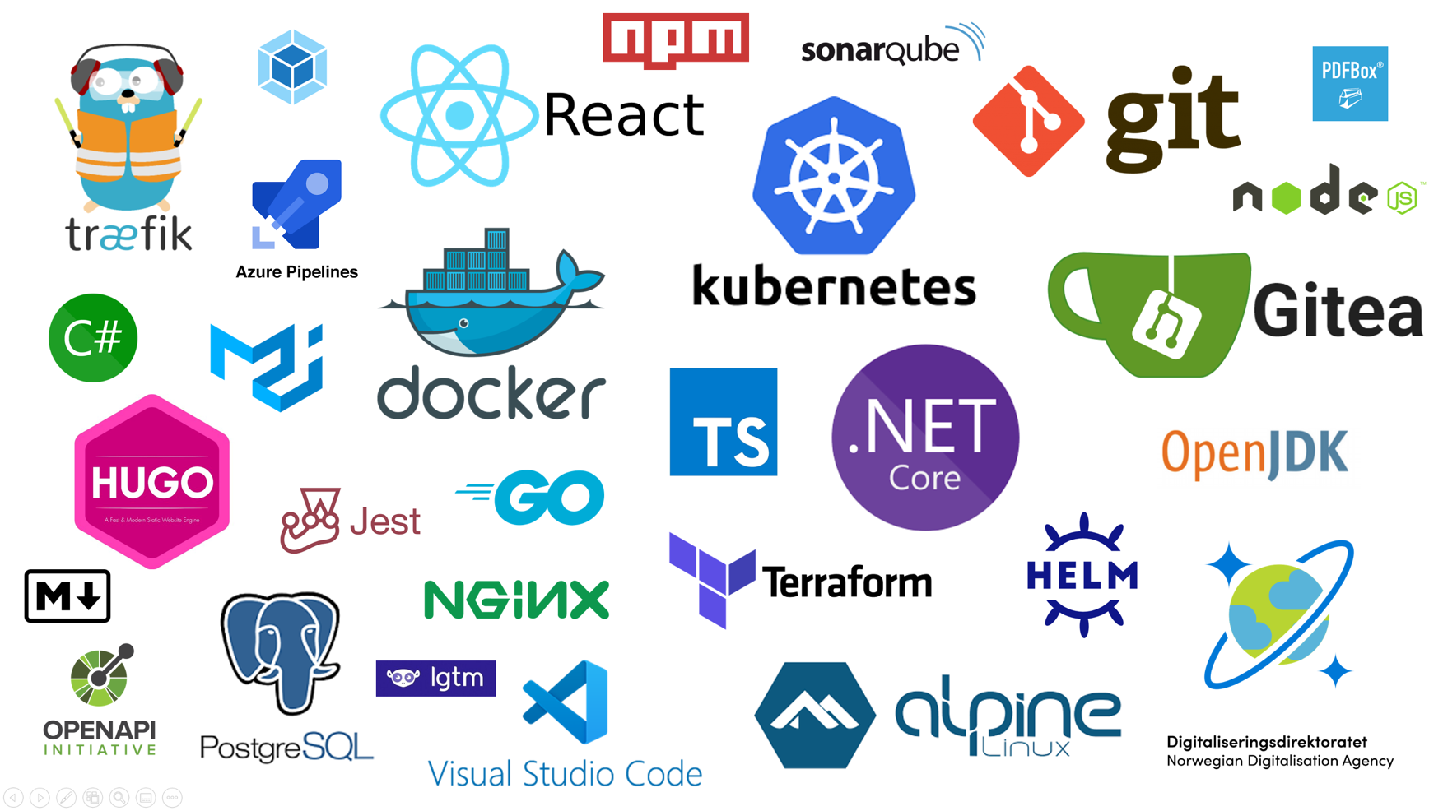
Notes:
This are some of the open source tools and frameworks we use.

Slide 21

Build as microservices
We want to scale components/apps differently, deployed independently, separate teams, reduced deploy time.
Components are created and deployed as microservices
Digital Services are created and deployed as microservices/apps
Building an open source government platform in the cloud
21
Copyright © 2020 Accenture. All rights reserved.
Notes:
We build the platform based on microservices pattern.
We want the possibility to scale the components and application differently, we want them to be deployed independently. We also want the possibility to have different teams being responsible for the different microservices.
So all components are deployed as microservices
All digital services created on the platform is deployed as microservices/microapps

Slide 22

Favor managed services
We want to reduce cost and complexity with hosting the platform.
Use managed PostgreSQL in Azure for Gitea
Use managed CosmosDB as document database
Use Azure blob storage for storing data
Use Azure Kubernets Services to manage the Kubernetes Clusters
Use Azure Api Management as API-management platform
Building an open source government platform in the cloud
22
Copyright © 2020 Accenture. All rights reserved.
Notes:
We Favor managed services
We are a small team and don't have the capacity to setup and host the different components required by our platform. Se we use fully managed services when we can.
We use Azure Kubernetes Services and other fully managed services.

Slide 23

Isolation between application owners
Reduce risk of operations issues or data loss between app owners
Separate Kubernetes Cluster per application owner
Separate blob storage for each application owner
Building an open source government platform in the cloud
23
Copyright © 2020 Accenture. All rights reserved.
Notes:
Isolation
We want to isolated the different government agencies from each other. We want to reduce risk of they affecting their performance or security.
So we give separate Kubernetes Clusters
We have separate data stores.

Slide 24
The solutions
Building an open source government platform in the cloud
24
Copyright © 2020 Accenture. All rights reserved.
Notes:
Concept + principles + POC
POC: 1 solution
Split: Designtime + Runtime
Split runtime in 2

Slide 25












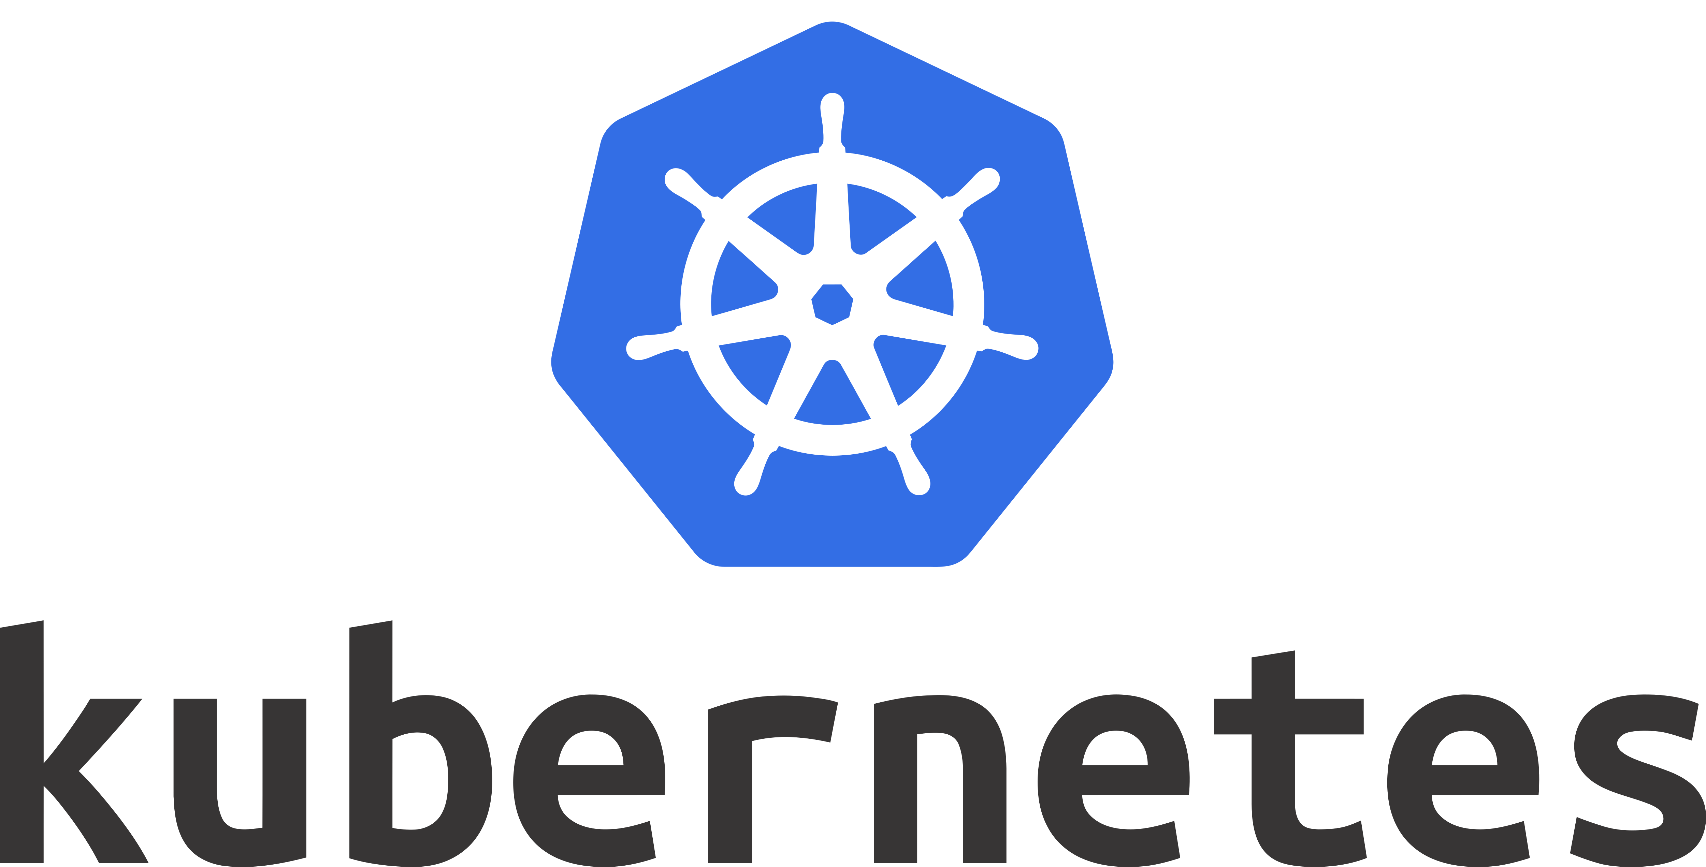
Altinn 3 is made up of 3 solutions
STUDIO
APPS
PLATFORM
DEPLOY APPS TO
SUPPORT
APPS
BLOB STORAGE
COSMOS DB
PDF
APP DEVELOPMENT AND TESTING
APP HOSTING
SUPPORTING PLATFORM
Building an open source government platform in the cloud
25
Copyright © 2020 Accenture. All rights reserved.
Notes:
3 solutions, working together

Slide 26
Altinn 3 is made up of 3 solutions
STUDIO
APPS
PLATFORM
DEPLOY APPS TO
SUPPORT
APPS
BLOB STORAGE
COSMOS DB
PDF
APP DEVELOPMENT AND TESTING
APP HOSTING
SUPPORTING PLATFORM
Building an open source government platform in the cloud
26
Copyright © 2020 Accenture. All rights reserved.
Notes:
Altinn Studio – design time solution
Create, develop, deploy
Applications -> Apps.
Runs on Kubernetes cluster in azure.

Slide 27
Altinn 3 is made up of 3 solutions
STUDIO
APPS
PLATFORM
DEPLOY APPS TO
SUPPORT
APPS
BLOB STORAGE
COSMOS DB
PDF
APP DEVELOPMENT AND TESTING
APP HOSTING
SUPPORTING PLATFORM
Building an open source government platform in the cloud
27
Copyright © 2020 Accenture. All rights reserved.
Notes:
Altinn Apps
All the running apps
The kubernetes clusters the apps run on

Slide 28
Altinn 3 is made up of 3 solutions
STUDIO
APPS
PLATFORM
DEPLOY APPS TO
SUPPORT
APPS
BLOB STORAGE
COSMOS DB
PDF
APP DEVELOPMENT AND TESTING
APP HOSTING
SUPPORTING PLATFORM
Building an open source government platform in the cloud
28
Copyright © 2020 Accenture. All rights reserved.
Notes:
Altinn Platform
Common backend functionality
Runs on kubernetes cluster in Azure.

Slide 29
Altinn 3 is made up of 3 solutions
STUDIO
APPS
PLATFORM
DEPLOY APPS TO
SUPPORT
APPS
BLOB STORAGE
COSMOS DB
PDF
APP DEVELOPMENT AND TESTING
APP HOSTING
SUPPORTING PLATFORM
Building an open source government platform in the cloud
29
Copyright © 2020 Accenture. All rights reserved.
Notes:
Look at how they work together.
Support next generation og digital services for the people of Norway

Slide 30
Government agency…
…needs data from population
Create digital service…
…to collect responses
Building an open source government platform in the cloud
30
Copyright © 2020 Accenture. All rights reserved.
Notes:
Govt agency, create digital service, collect data.
Create app using Altinn 3

Slide 31

Key features
Flexible solution
Modern UI
Quick, iterative development
Self-service deploy
Building an open source government platform in the cloud
31
Copyright © 2020 Accenture. All rights reserved.
Notes:
Pain points from existing platform, improve on
Super-flexible, easy to customize
Modern UI – desktop/mobile
Quick, iterative testing
Self-service deploy
Scale apps up/down as needed.

Slide 32



App frontend
App template
End user
Authentication
Flexible solution Altinn Apps
Authorization
Supporting libraries
Configuration
JSON
XML
App logic
Altinn Platform
Copyright © 2020 Accenture. All rights reserved.
Notes:
What is app in this context – digital service, in the form of a standalone application, exposes API, has GUI, runs in a docker container.
Created template – starting point for apps
- .NET core MVC
Supporting libraries – Nuget (APIs, platform)
Placeholders custom logic
Configuration files
Refers to app frontend
React- application
Loaded at runtime from CDN
All apps use same frontend by default.
Integrates with app via APIs
Can be configured – views for different process tasks, set up form.

Slide 33
Flexible solution Customizing the app
Process
BPMN 2.0
Data, Confirmation, Feedback
Authorization policy (XACML)
Custom logic
Validation, calculation, data prefill, etc.
Fetch data from platform or external APIs
Create & expose APIs
Data
Data
Confirmation
Feedback
Copyright © 2020 Accenture. All rights reserved.
Notes:
Customize app template
Process: defines tasks end user must og through.
Example: Fill in form (data), confirm data (confirmation), wait for feedback from agency (feedback).
3 types of process tasks, can be combined in any way.
Done through process configuration file.
Use existing standards when possible:
Process: BPMN 2.0 – xml notation for defining processes
XACML – xml standard for defining access control
Authorization:
App as a whole, or single process tasks.
Custom logic
Placeholders: validation, calculation, prefill – just the start
Fetch data from platform, external APIs
Expose APIs
Example: send email at end of process task
Could og on – if you can code it, you can do it!

Slide 34
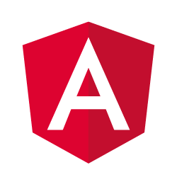

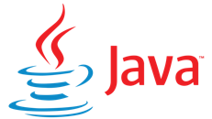
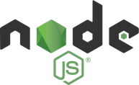


App frontend
App template
Q: Why do Java developers wear glasses?
A: Because they don’t C#!
End user
Authentication
Flexible solution Altinn Apps
Authorization
Supporting libraries
Configuration
JSON
XML
App logic
Altinn Platform
Copyright © 2020 Accenture. All rights reserved.
Notes:
Recall – apps use same frontend by default.
Imagine this is doesn’t cut it.
Replace with something different
Drop frontend entirely, integrate via APIS and system
Nothing stopping from doing the same with the app template itself.
Java application?
.NET person at heart – why replace amazing, beautiful .NET Core app template???
Joking aside, if standard app template doesn’t do it, feel free to replace.
Future: set of app templates using different technologies, choose when creating app?

Slide 35
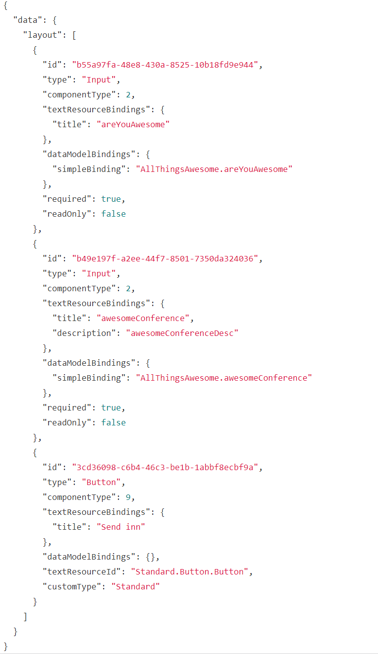
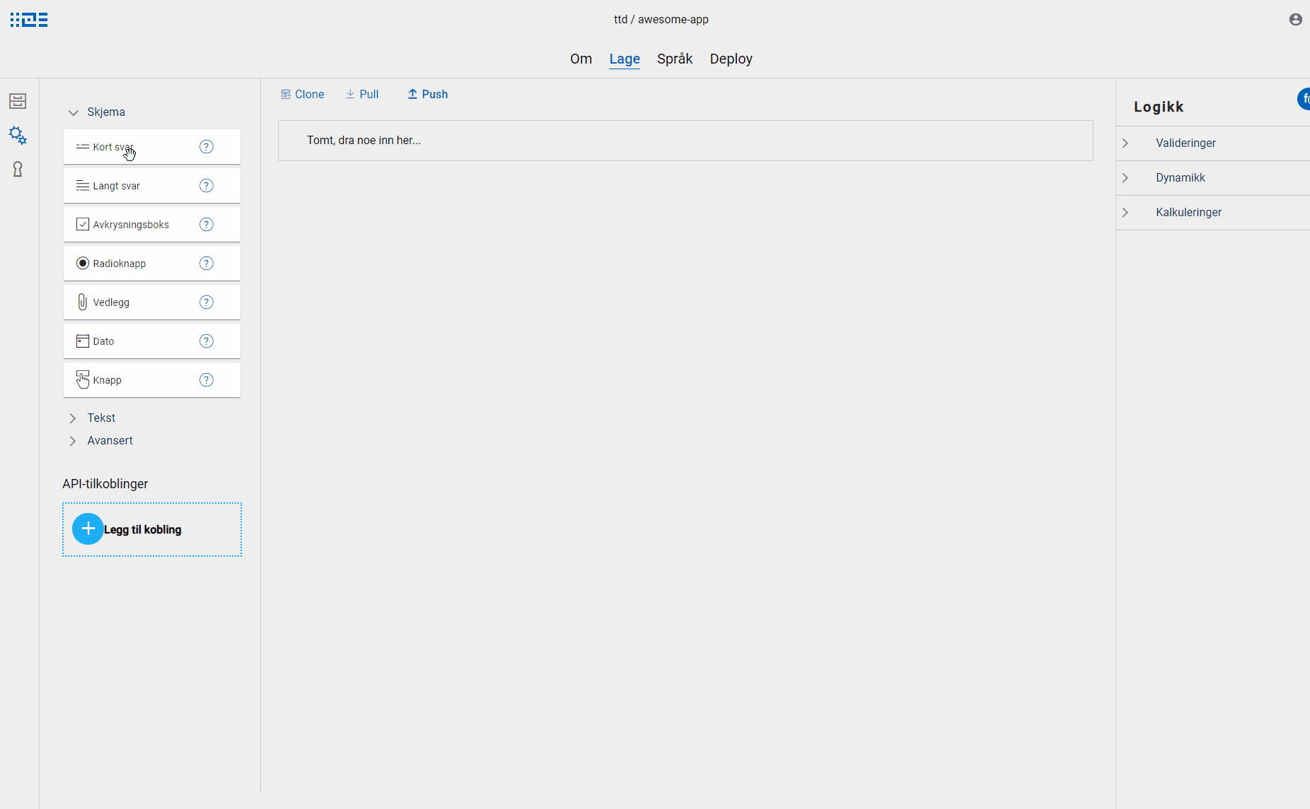
Modern UI Altinn Studio
Building an open source government platform in the cloud
35
Copyright © 2020 Accenture. All rights reserved.
Notes:
Let’s assume you want to keep the app template/frontend as is. Want UI to look modern, work on both desktop& mobile.
One of the ways to configure UI is by creating a form, to collect data.
Build our own tool, instead of existing tools
Part of Altinn Studio solution
Drag & drop Forms builder – React + Redux
Library of components
Only simple forms
[CLICK]
Form layout, configuration -> JSON file.

Slide 36
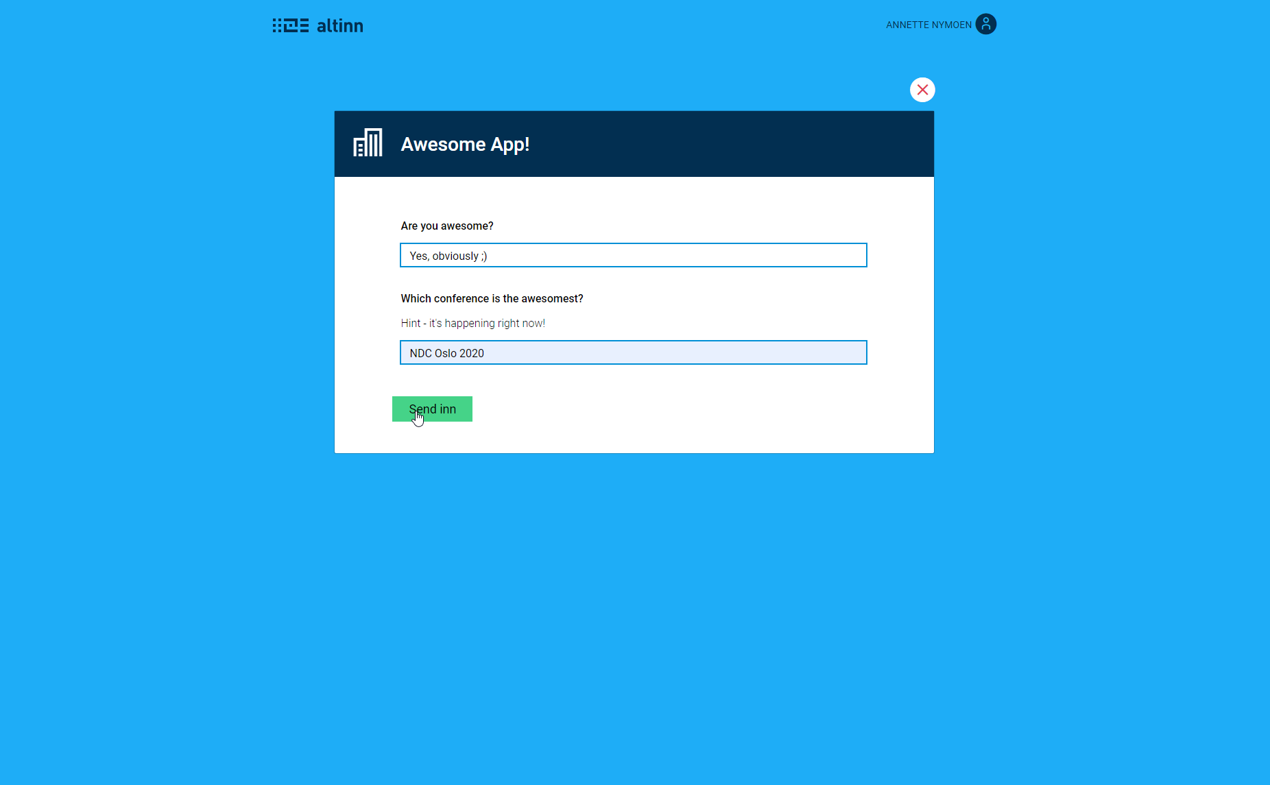
Modern UI Altinn Apps
Building an open source government platform in the cloud
36
Copyright © 2020 Accenture. All rights reserved.
Notes:
Runtime:
Parses JSON file
Renders form

Slide 37
Modern UI Altinn Apps
Data
Data
Confirmation
Feedback
Building an open source government platform in the cloud
37
Copyright © 2020 Accenture. All rights reserved.
Notes:
Frontend supports different process task types.
Form -> data task type
Configure views for other task types – configure content/texts.

Slide 38


Altinn Studio
Load balancer
App developer
Git API
Repository
(Gitea)
Designer
Frontend
Local development tools
Quick, iterative development Altinn Studio
Dashboard
Application development
Backend
Copyright © 2020 Accenture. All rights reserved.
Notes:
So far, talked about the apps – but how to we actually develop them into complete digital services?
Done in Altinn Studio solution.
3 parts:

Slide 39
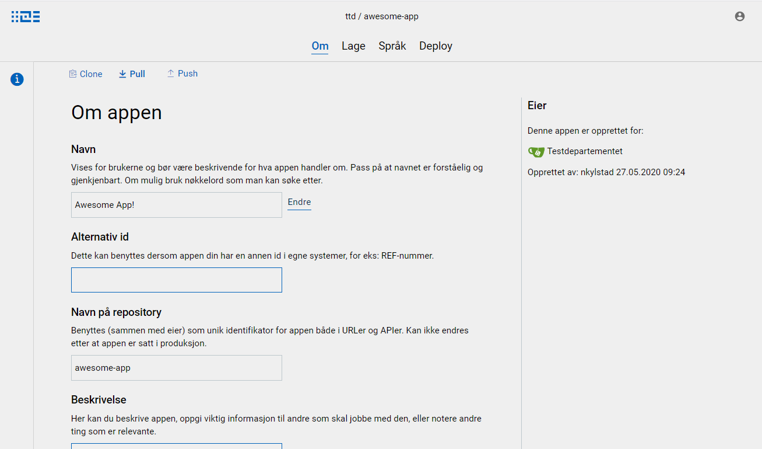
Altinn Studio
Load balancer
App developer
Git API
Repository
(Gitea)
Designer
Frontend
Local development tools
Quick, iterative development Altinn Studio
Dashboard
Application development
Backend
Copyright © 2020 Accenture. All rights reserved.
Notes:
Designer
GUI
Forms builder
Text editor
Add data model
Simple code editing
Deploy
Integrates with

Slide 40
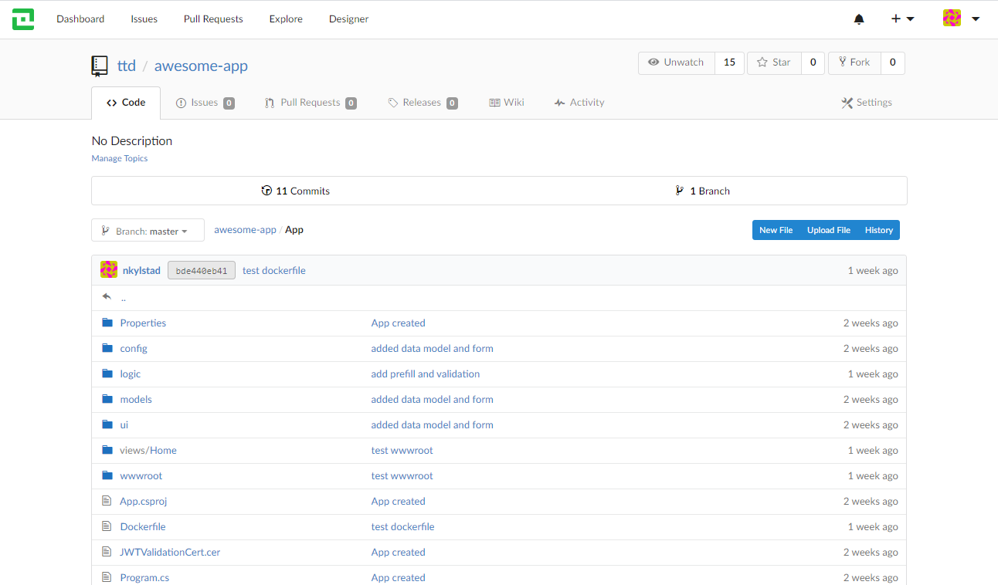
Altinn Studio
Load balancer
App developer
Git API
Repository
(Gitea)
Designer
Frontend
Local development tools
Quick, iterative development Altinn Studio
Dashboard
Application development
Backend
Copyright © 2020 Accenture. All rights reserved.
Notes:
Repository: where all the apps in Altinn Studio are stored.
Built on Gitea – open source code hosting solution using Git. Looks a bit like github.
Each app is stored in a git respository.
When app developer works on app in designer, they have local clone for their user.
Make changes, push to central app repository.
Easy for multiple developers to work on app
All files are version controlled.

Slide 41
Altinn Studio
Load balancer
App developer
Git API
Repository
(Gitea)
Designer
Frontend
Local development tools
Quick, iterative development Altinn Studio
Dashboard
Application development
Backend
Copyright © 2020 Accenture. All rights reserved.
Notes:
Loadbalancer
Route to designer/repository based on url

Slide 42
Altinn Studio
Load balancer
App developer
Git API
Repository
(Gitea)
Designer
Frontend
Local development tools
Quick, iterative development Altinn Studio
Dashboard
Application development
Backend
Copyright © 2020 Accenture. All rights reserved.
Notes:
Building application through GUI – cool, but not everything is supported.
Some developers might like to use their own tools, especially when writing code.
Support Local development, favourite tools
App created, clone to your computer, work locally.
Once done, push back up to studio repo for deploy.

Slide 43

Quick iterative testing Platform mock
Easily test changes locally
Avoid time-consuming deploy
Used by dev team as well
Copyright © 2020 Accenture. All rights reserved.
Notes:
Important aspect of developing app – TESTING!
Apps need Altinn Platform to run.
Deploy to test environment, where Altinn Platform is running
Time consuming, testing things like small UI changes
Test locally: Created Platform Mock
Downloaded, run in parallel with apps
Quick testing of changes on the fly
Used by dev team when developing new functionality for the apps

Slide 44

Self-service deploy
Deploy to test environment at the click of a button.
Deploy to production at the click of a button.
Copyright © 2020 Accenture. All rights reserved.
Notes:
Apps are deployed from Altinn Studio to a kubernetes cluster in Altinn Apps.
Each app owner/govt agency has their own kubernetes cluster to deploy to – both test env. And production.
The apps of 1 agency do not affect the apps of another agency.
This allows for self-service deploy, all the way to production.

Slide 45
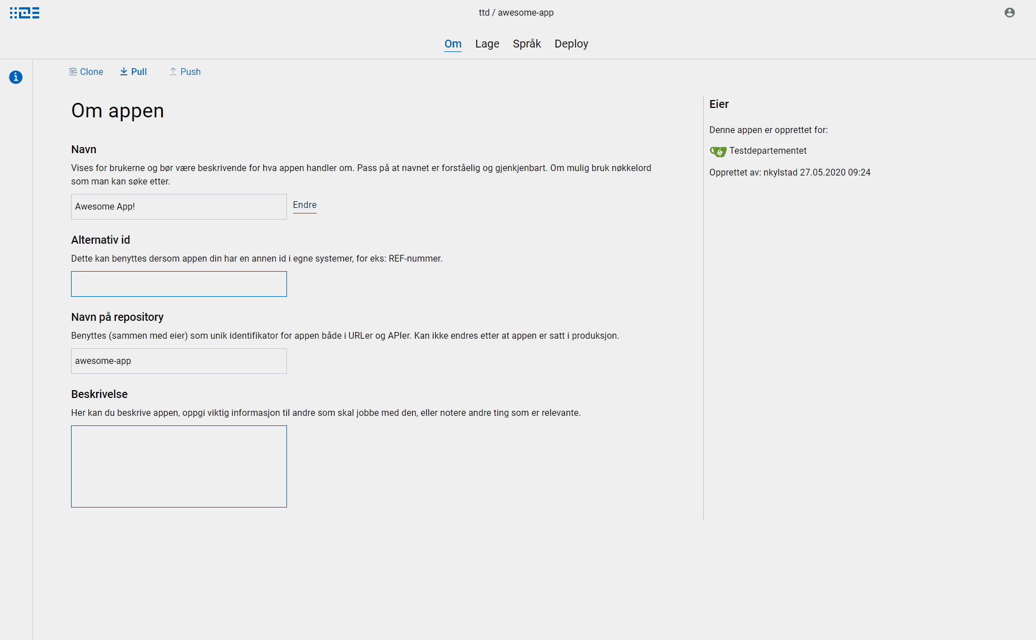
Self-service deploy Altinn Studio
Copyright © 2020 Accenture. All rights reserved.
Notes:
Deploy is a 2-step process
Build the app
Builds a docker image for the app
Pushes to Azure Container Registry
Azure Devops Pipeline
Deploy to wanted environment
Fetches docker image from Container Registry
Deploys to specified environment
Azure Devops pipeline.

Slide 46

Flexible scaling
Applications run in docker containers
Applications can be scaled up/down based on traffic
Copyright © 2020 Accenture. All rights reserved.
Notes:
In cluster, Each app deployed to 1 or more pods
Scale up/down based on load
Avoid fully scaling everything all the time – current platform.
Setup - later
Altinn platform - now

Slide 47


App
End user
Application Gateway
API Management
Agency
Ingress Controller (Traefik)
Altinn
Platform architecture
Altinn Platform
REST
REST
REST
REST
REST
REST
REST
Altinn II (on prem)
Authentication
Authorization
Profile
PDF
Receipt
Register
Storage
Blob storage
Cosmos DB
Copyright © 2020 Accenture. All rights reserved.

Slide 48
Public cloud components & architecture
Building an open source government platform in the cloud
48
Copyright © 2020 Accenture. All rights reserved.
Notes:
- Deploy, arch + public cloud comp
- This winter, Only large cloud provider
- Not yet fully available
- Redundancy within Norway
- Low latency (users, cloud & on prem)
Nina & Rune
How do we get from C# to running serivce – the exciting this, app owners

Slide 49






From code on GitHub to running services online
AKS Cluster
Container registry
Deploying a micro service to Azure Kubernetes Service Cluster is done without any downtime.
Build pipeline
Docker images / container owned by different parties should be stored in different registries. Container registry should adhere to the requirements of the strictest environment they will be deployed to.
Release pipeline
Pipeline consists of two steps. Building a docker image and then pushing the docker image to Azure Container Registry. Pipeline is granted contributor access to Azure Container Registry
Standard pipeline contains two tasks: installing HELM on agent and helm upgrade(/install) command to install the microservice on the Kubernetes cluster.
Helm charts and sensitive environment variables are stored in a separate Azure Repo and made available for the release pipeline as an artefact.
Source control
Public GitHub repository for everything that we develop. Our user’s application repos are stored in Gitea protected, but available for all registered Altinn Studio users.
Copyright © 2020 Accenture. All rights reserved.
Notes:
LGTM + SonarCloud to mention a few
Once we have a new feature or app developer decides it's time to build app
Pipeline triggered in AzDo. - Ready template
Build & push image
CR – store imge until ready.
Two things to keep in mind with CR.
- Public platform, trust, separate container reg
- Single image several env, Our policy: treated as a production resource: access, availability region
Relese pipeline to instsll: HELM
Azure Repo: sensitive data: helm + instr key. Artifact

Slide 50
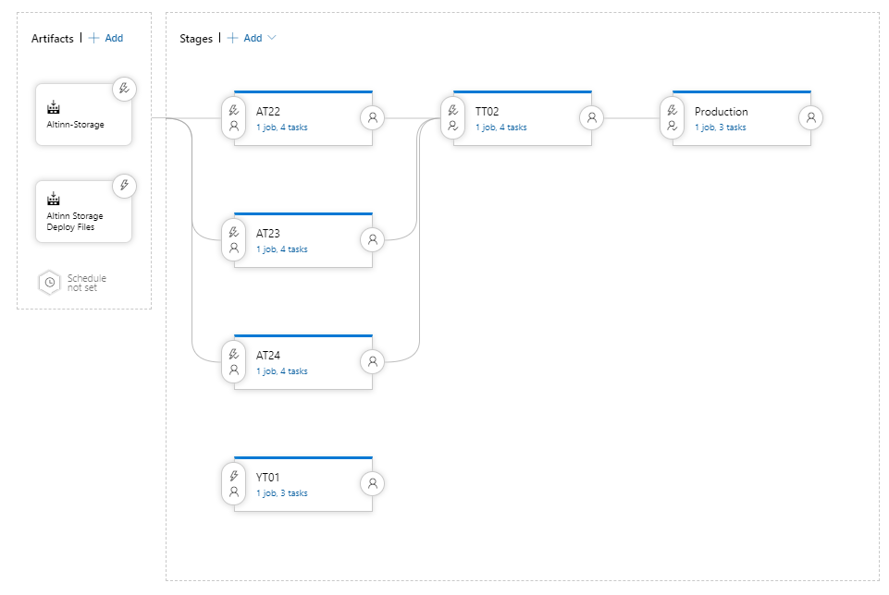
Release pipeline for a platform component
Copyright © 2020 Accenture. All rights reserved.
Notes:
What we se here..

Slide 51
Release pipeline for a platform component
Copyright © 2020 Accenture. All rights reserved.
Notes:
Artifacts: ref to identify correct docker image
helm charts from the separate repo

Slide 52
Release pipeline for a platform component
Copyright © 2020 Accenture. All rights reserved.
Notes:
Acceptance, Load, App Owner, Production
Triggers
Manual approvals before triggering pipeline
The most important task int pipelines is a Helm upgrade/install task.
result: new pod spins up

Slide 53
From code on GitHub to running services online
AKS Cluster
Container registry
Deploying a micro service to Azure Kubernetes Service Cluster is done without any downtime.
Build pipeline
Docker images / container owned by different parties should be stored in different registries. Container registry should adhere to the requirements of the strictest environment they will be deployed to.
Release pipeline
Pipeline consists of two steps. Building a docker image and then pushing the docker image to Azure Container Registry. Pipeline is granted contributor access to Azure Container Registry
Standard pipeline contains two tasks: installing HELM on agent and helm upgrade(/install) command to install the microservice on the Kubernetes cluster.
Helm charts and sensitive environment variables are stored in a separate Azure Repo and made available for the release pipeline as an artefact.
Source control
Public GitHub repository for everything that we develop. Our user’s application repos are stored in Gitea protected, but available for all registered Altinn Studio users.
Copyright © 2020 Accenture. All rights reserved.
Notes:
A new pod spins up and the referenced image if pulled onto the pod
& micro service starts up.
Ensured that service is fully up & running before terminating
Deploy without downtime
This is our overall process for getting from code on GitHub to running services.
SAME PROCESS for Apps – of course run on separate pipelines
Let's take a look at how this looks in Azure once all the micro services are deployed.

Slide 54
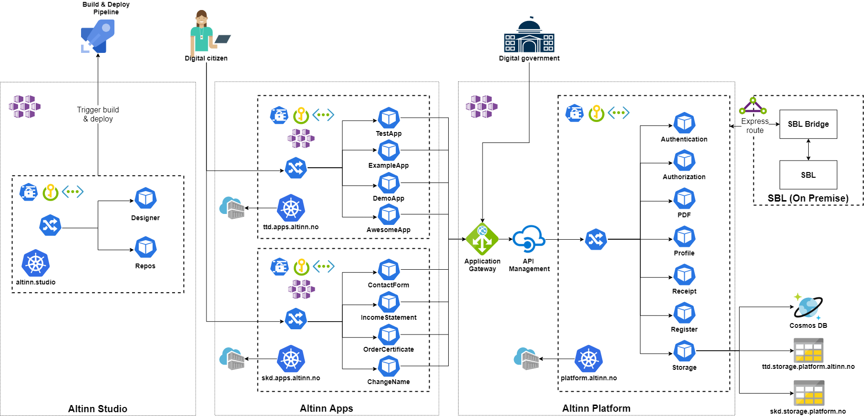
Cloud infrastructure
Copyright © 2020 Accenture. All rights reserved.
Notes:
Overview of how we've set up infrastructure in Azure for the different solutions
PAUSE

Slide 55
Cloud infrastructure
Copyright © 2020 Accenture. All rights reserved.
Notes:
Separate Kubernetes Cluster
Each service in their own docker container
Within Studio Infra we find
Keyvault (secrets & certificates)
Virtual network
Load balancer (incoming network traefik)
Ingress route (route to correct micro service)
Build/Release pipeline used during app deploy.

Slide 56
Cloud infrastructure
Copyright © 2020 Accenture. All rights reserved.
Notes:
Two examples of app clusters with running applications
Each app owner gets their own Azure subscription containing
- AKS cluster
- key vault
- virtual network
- Container registry
- storage account (store the data collected through their apps)
- Ingress route – route traffic to the correct app
Common for the apps is that many will require the shared platform resources.

Slide 57
Cloud infrastructure
Copyright © 2020 Accenture. All rights reserved.
Notes:
App Gateway
APIM
Before being routed to the correct service
Platform in a separate K8s cluster
Each platform component runs on their own docker container
LinkerD – encrypted – pod-to-pod (saves us from routing the traffic through the internet.)
Storage – Connects to cosmosDB or storage account depending on who owns the data it is handeling in a given transaction.

Slide 58
Cloud infrastructure
Copyright © 2020 Accenture. All rights reserved.
Notes:
Express route – high speed communication between on prem and cloud solution

Slide 59
Cloud infrastructure
Copyright © 2020 Accenture. All rights reserved.
Notes:
Varying level og how consisten the components are
Apps: new app owners, requests for new cloud components or upgrades.
Good way to set up our infrastructure. TERRAFORM.
Provisioning & evolving infra as code.
As you can see here, a number of cloud components have been used
Parallells to technology on premise – but not always
Based our decisions when picking one cloud component above another and deviding how to configure the components in Azure on the points you can see here...

Slide 60
How have we selected which components to use?
Available
documentation​
Conversations with Microsoft​
Experience
within the community
Which components do we think have the potential to evolve along with our platform and the capabilities we expect to offer in the future
Copyright © 2020 Accenture. All rights reserved.
Notes:
KUNSTPAUSE
The point right at the bottom..
Which compoents..
I think it says something about daring to imagine how the future might look like
And in some cases doing the nessesary work to ensure that our needs & expectations are made clear to those developing new functionality for Azure.

Slide 61
Cloud Components Summary
Azure Kubernetes Services (AKS)
Azure Function Apps
Fully managed service used to host our Kubernetes clusters.
Hosts functions for cleaning up and backing up the data in Cosmos DB.
Cosmos DB
Azure Container registry
Document database where we store metadata about the applications and their instances.
Registry for storing and managing all docker images.
Azure Key Vault
Azure Blob Storage
Service for storing and managing keys, secrets and certificates. Vault is accessible from micro service.
Blob storage used to store each application instance’s blobs.
Azure Database for PostgreSQL server
Loadbalancer
Fully manages databased used by Gitea as the central source for all application repositories.
Balances incomming network traefik across nodes in the AKS cluster.
Azure Virtual Network
API Management
Allows for a private network within each AKS cluster to ensure secure communication.
Component used to administrate the APIs in Altinn Platform as well as enforce policies and control access.
Application insights
Application Gateway
Application performance management service used to monitor all micro services in the solution.
Web traffic load balancer used to manage traffic to Altinn Platform.
Express Route
Used to create a private network connection between the on-prem and cloud environment.
Copyright © 2020 Accenture. All rights reserved.
Notes:
Most central components we are currently using in our solution. (PAUSE)
Fully managed – limits number of vars for us to tweak & time spent maintaining them.
– would not have had the capacity if not
The reason for emphasising that these are the components that we're using at the moment
development before data centers were established in norway. (Had to adapt to what would be offered in this region. )
rapid evolution of cloud technology,
We're forced to always be prepared to incorporate new capabilities introduced by Microsoft into our solution.
Luckily, terraform makes it really easy to both upgrade and introduce new components.
Cost management. - save costs without affecting performance

Slide 62
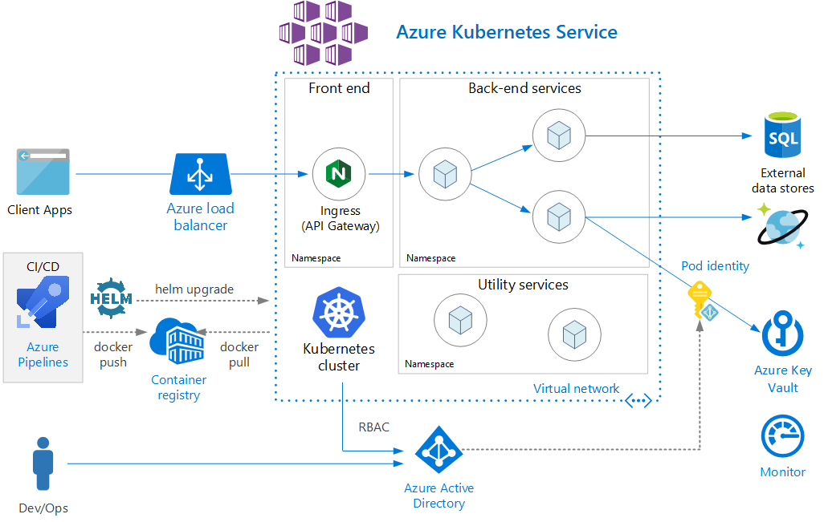
Azure Kubernetes Services
Copyright © 2020 Accenture. All rights reserved.
Notes:
Fully managed.
Few responsibilities outside of: deploy/managing our micro services
Auto scaling - with varying load
Several hundred clusters. Microsoft's Azure team, we will manage just fine.

Slide 63
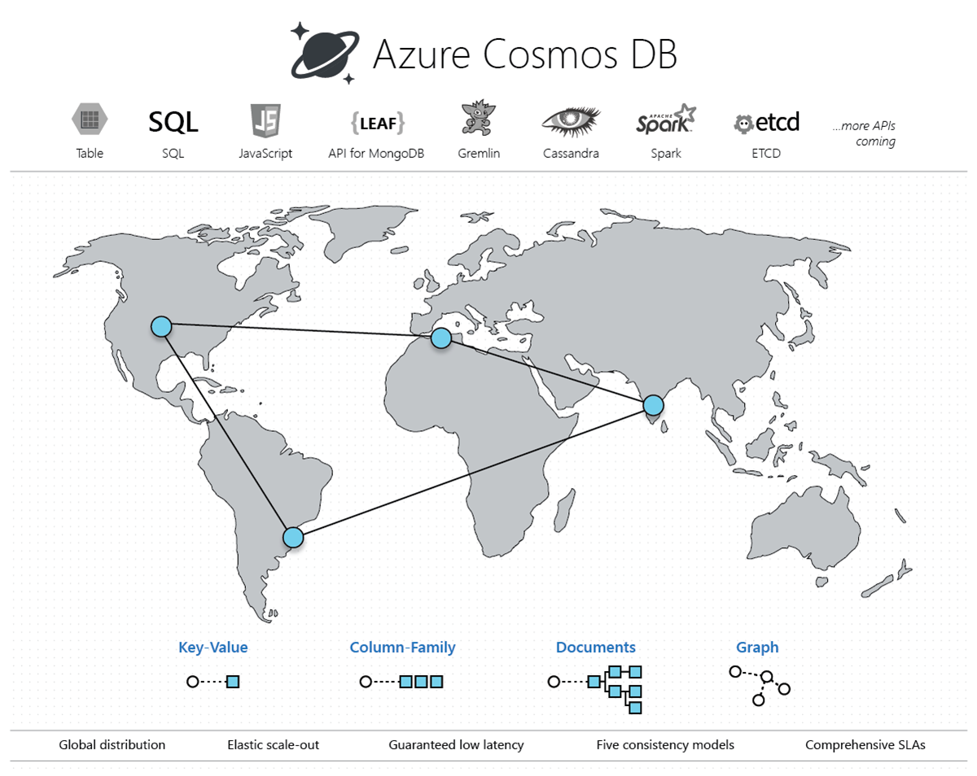
Azure Cosmos DB
Copyright © 2020 Accenture. All rights reserved.
Notes:
Store metadata about the apps and their instances
Highly available – 99.999 %
Auto duplication
Unlimited amout of storage hosted in Azure
Auto scaling just announced – looking forward to incorporate this

Slide 64
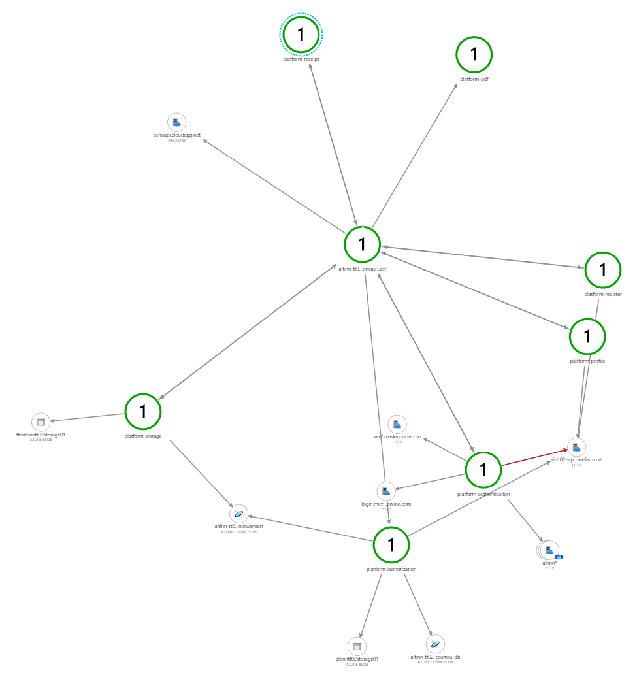
Application Insight
Monitors applications, platform components, API-management, Kubernetes
Number of calls, latency, code, exceptions
Helps us identify bottle necks
Alerts
Copyright © 2020 Accenture. All rights reserved.
Notes:
Bug and you don’t know where to begin
9/10 times
Monitor av microservices (platform, studio, apps)
Application map – micro services & other resources in azure
One of the features AI provides is

Slide 65
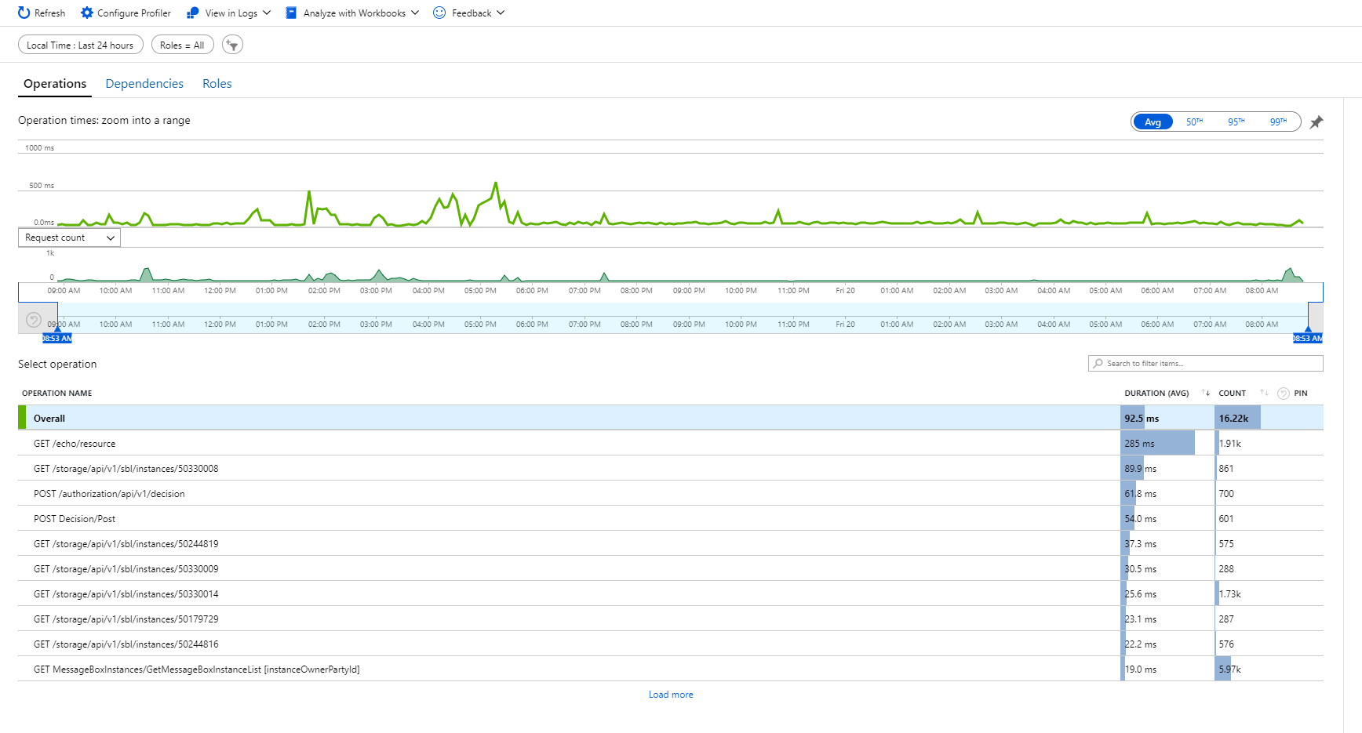
Copyright © 2020 Accenture. All rights reserved.
Notes:
Time frame
Which are used more often
Average response time
Another feature

Slide 66
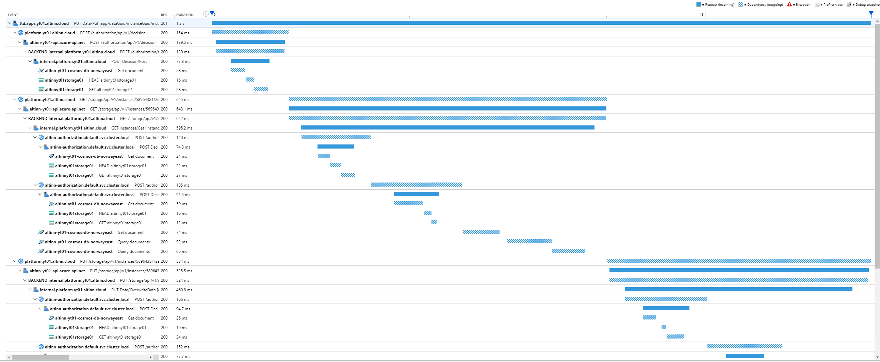
Copyright © 2020 Accenture. All rights reserved.
Notes:
Drill into single request
See flow through our service
These two features – load testing
Bottle neck, unnessesary requests
Hand over Nina

Slide 67
Experiences
Building an open source government platform in the cloud
67
Copyright © 2020 Accenture. All rights reserved.

Slide 68
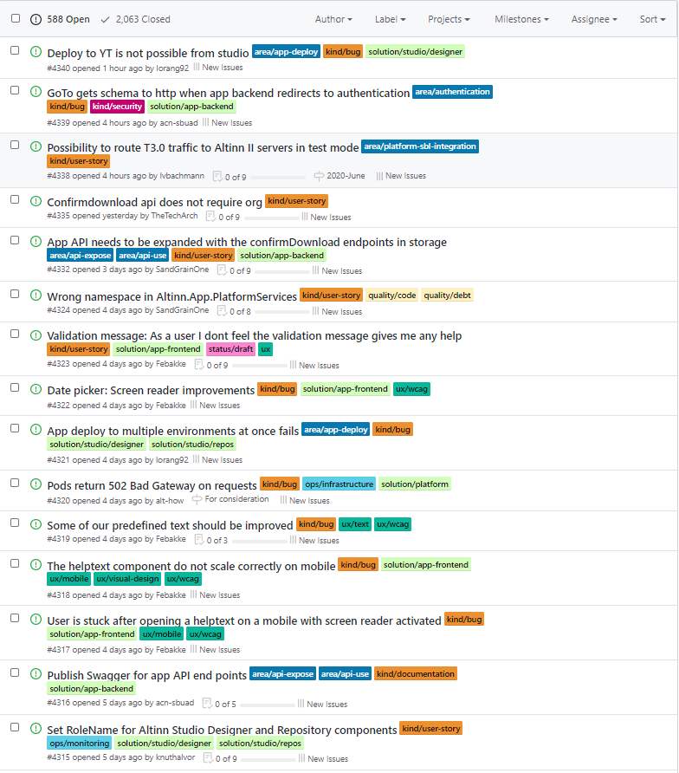
Experiences
Open source
«Vanilla» Github as a project planning tool
Shifting direction mid-project can be a good thing!
Copyright © 2020 Accenture. All rights reserved.
Notes:
Open-source project – great!
Backlog open on github – screenshot from a few days ago.
Feedback and wishes from app developers from very early stage
Submit issues, and follow progress.
Since we use only open-source projects, we can do the same
Modify things to suit our needs
Insight into when new functionality becomes available
While having an open backlog on github has been a good thing, the tool itself is lacking when it comes to managing and prioritizing the backlog of a project of this scale. We are currently a small team, which makes it manageable – previously, when we were a larger team, it was difficult to keep track of everything that was happening. We have had to test several different plugins with varying degrees of success.
Finally – a note direction. When describing the overall concept we are working towards, Rune mentioned that we want to build a tool for people with little or no programming skills. However, as you may have seen when we took you through the solutions, we do focus on customization, and the app developers building «whatever they want». This definitely requires some programming skills!
In the beginning of this project, we focused users without coding experience, and on Altinn Studio – the tool to build apps, especially the GUI. Because of this, we lost sight of the actual apps the tool was producing. By deciding to shift our focus to users who do know coding, we could spend less time on the GUI for creating apps, and more time on functionality for the apps.
Although the decision resulted in us abandoning a lot of work that had been done on Altinn Studio, especially on the design side, we do feel that this was the right decision looking back now.
We do aim to get back to the Altinn Studio tool, to develop it into a user-friendly tool for both developers and non-developers.

Slide 69
Status
Building an open source government platform in the cloud
69
Copyright © 2020 Accenture. All rights reserved.

Slide 70

We went live on Monday!

Slide 71

Current status
Environments available to some pilot agencies
Around 600 open issues on GitHub
Working with pilots to establish the first services in production
Everyone is still working from home
Copyright © 2020 Accenture. All rights reserved.

Slide 72
What is next
Support more Advanced forms
More types of process task
Event
architecture
Multiple pages, tables, subforms
Payment, signing, lookup
How to make a
event feed for every citizen and business of Norway
Copyright © 2020 Accenture. All rights reserved.

Slide 73
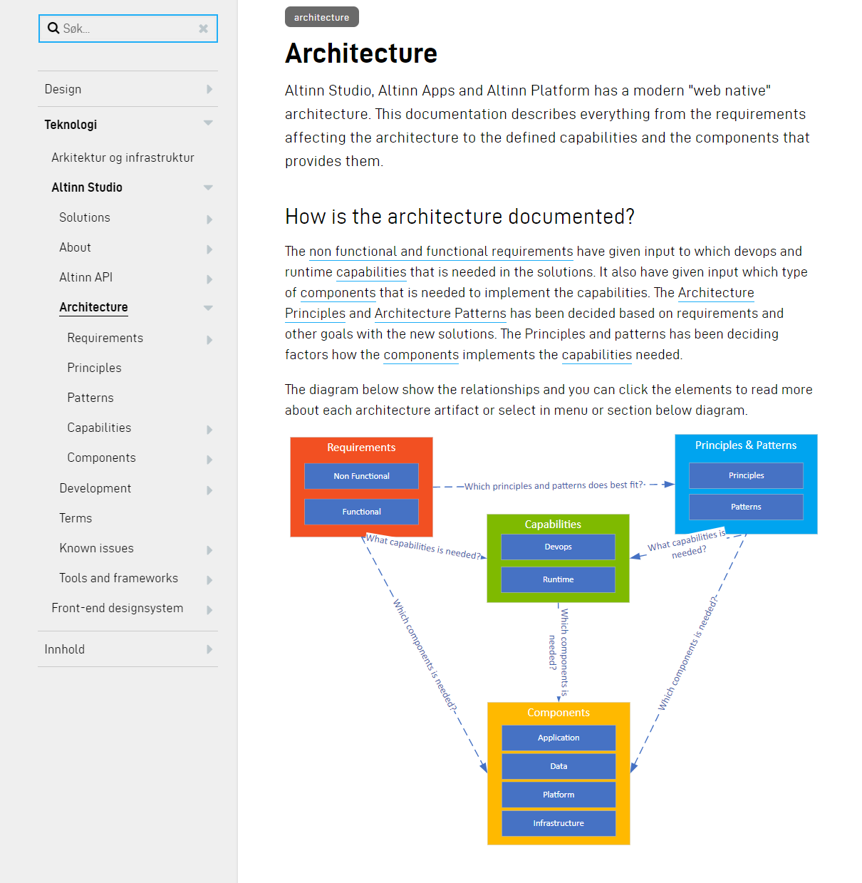
Documentation
Full Architecture is documented online
Requirements
Principles
Patterns
Capabilities
Components
Copyright © 2020 Accenture. All rights reserved.

Slide 74

Thank you!
https://github.com/Altinn/altinn-studio
Rune T. Larsen
TheTechArch (on Github)
Nina Kylstad
nkylstad (on Github)
Stephanie Buadu
acn-sbuad (on Github)
rune.tommeras.larsen@accenture.com
nina.kylstad@accenture.com
stephanie.buadu@avanade.com
@thetecharch
@nkylstad
@sbuadu
Copyright © 2020 Accenture. All rights reserved.
Notes:
Thanks to NDC for having us.
Our host [insert name]
& all you guys for taking time to listen to our talk.
We'll take some questions now, and if we run out of time or you should have any other feedback please reach out to one of us on slack!

